Slide 1
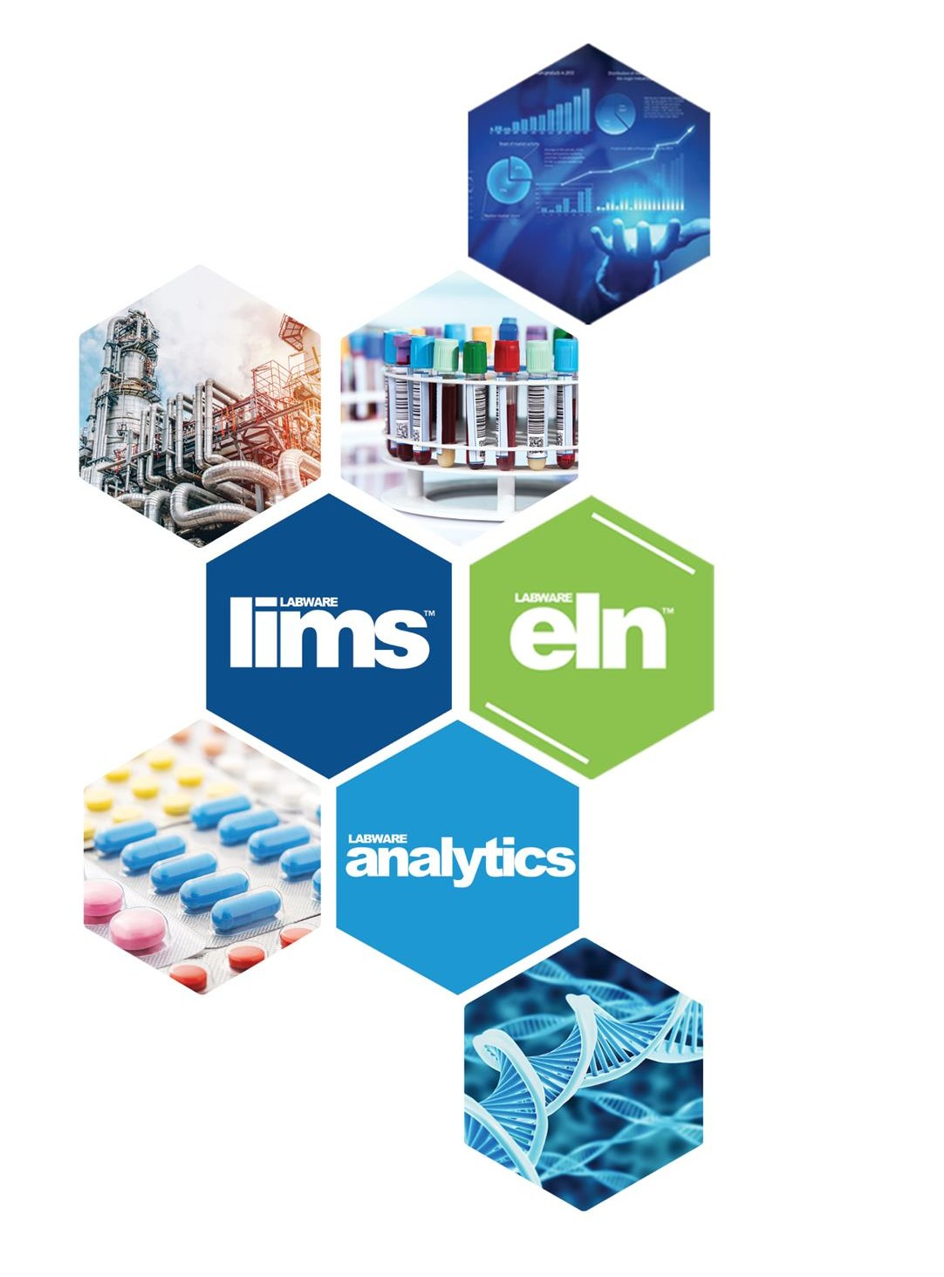


Data Science Engine Template
Use Case - RUL

Slide 2

Motivation
In order to sustain the fierce market competitiveness, companies are driven by the search for more optimized and cost-effective maintenance processes. The correct choice of the maintenance management model that an industry adopts directly affects costs, as well-executed planning contributes to waste reduction and improves machine utilization.

Slide 3
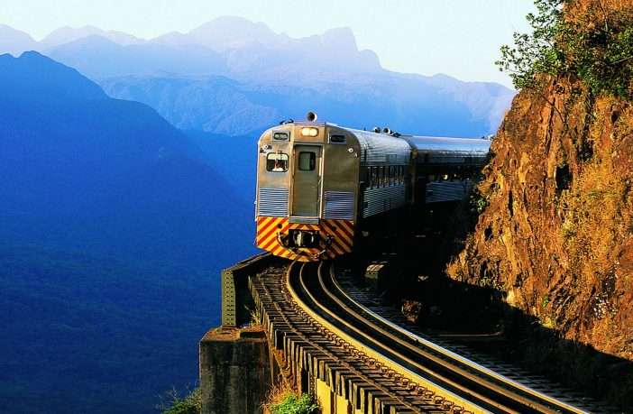
Problem
Not all data generated during maintenance processes is used in planning calculations.

Slide 4
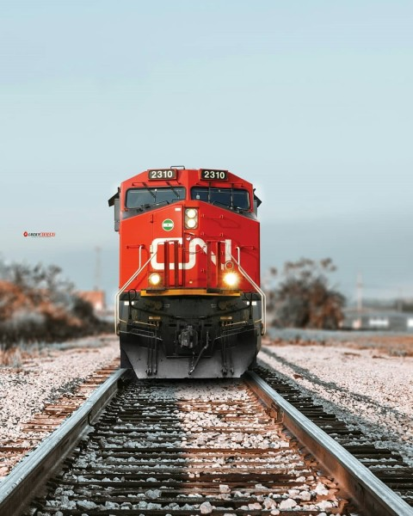
Problem
Not all data generated during maintenance processes is used in planning calculations.
Solution
Creation of a data integration system for predicting the remaining useful life of equipment.

Slide 5
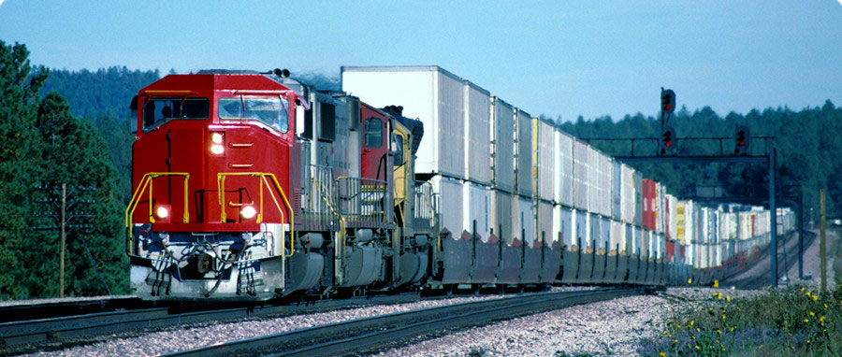
Rail Transport
Railway transportation is a crucial component of the infrastructure, especially for the transport of heavy freight over long distances, being an advantageous alternative compared to other means of transportation and presenting a low environmental impact.

Slide 6
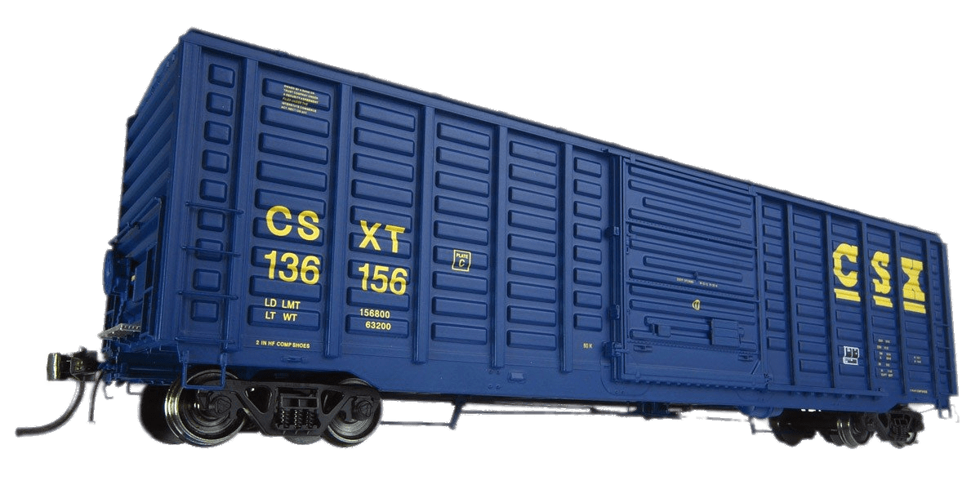

Wagons

Slide 7
Railway Maintenance
Railway maintenance refers to the activities and processes involved in ensuring the safe and efficient operation of railway infrastructure, equipment, and rolling stock. It plays a crucial role in maintaining the reliability, availability, and longevity of railway systems.
Types of Maintenance:
Corrective
Preventive
Predictive

Slide 8
System
Laboratory – Maintenance Tests
Maintenance History
Remaining Useful Life (RUL)
Machine Learning technique: Random Forest *
* Source: Mathew, V., et al.. Prediction of Remaining Useful Lifetime (RUL) of turbofan engine using machine learning. Available in <https://ieeexplore.ieee.org/document/8326010/>

